Slide 1
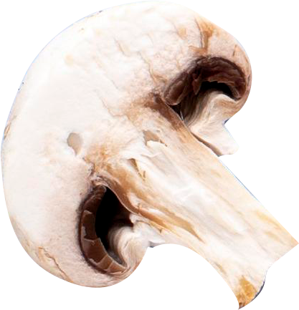
Mushroom Edibility Classification
AIML CA1
Wong Zhao Wu

Slide 2
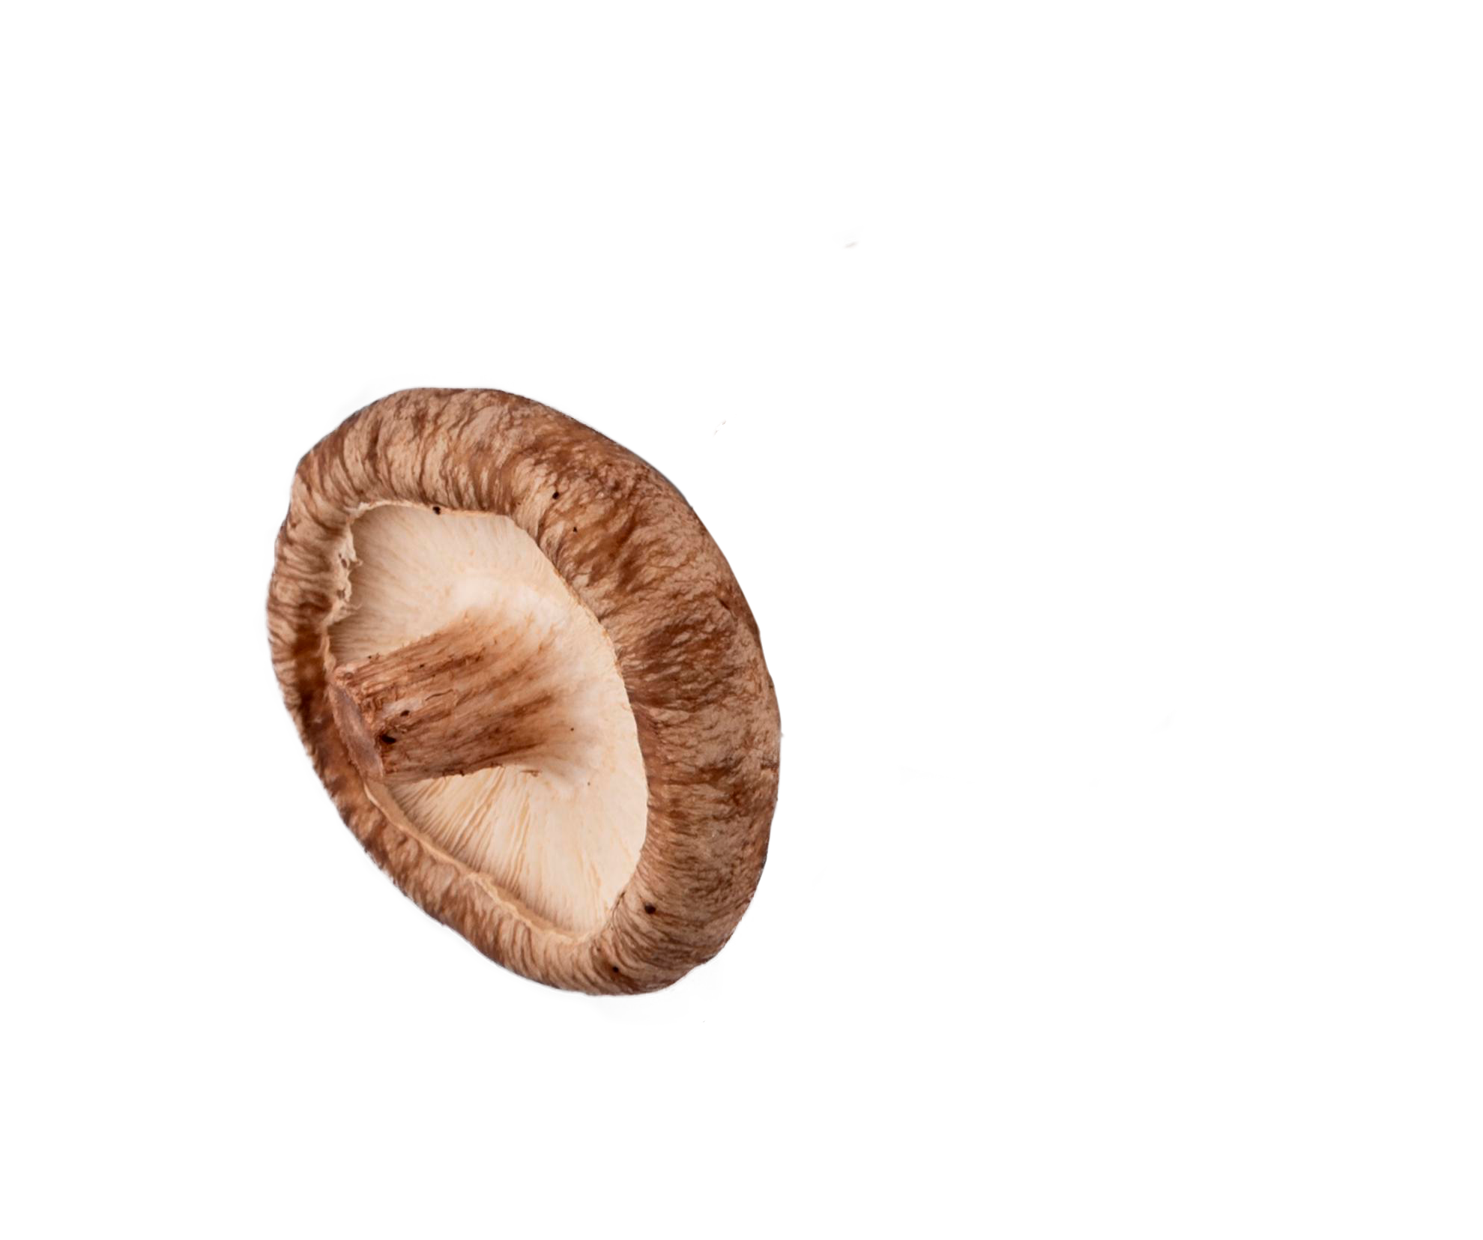
Table of contents
01
02
03
04
EDA
Data Preprocessing
Understands the dataset and flag out flaws in the dataset.
Preprocess dataset into a format that is digestible by model.
Modeling
Model Interpretation
Train and Evaluate Models based on Modelling Objective.
Interpret the model and its decision rule.

Slide 3
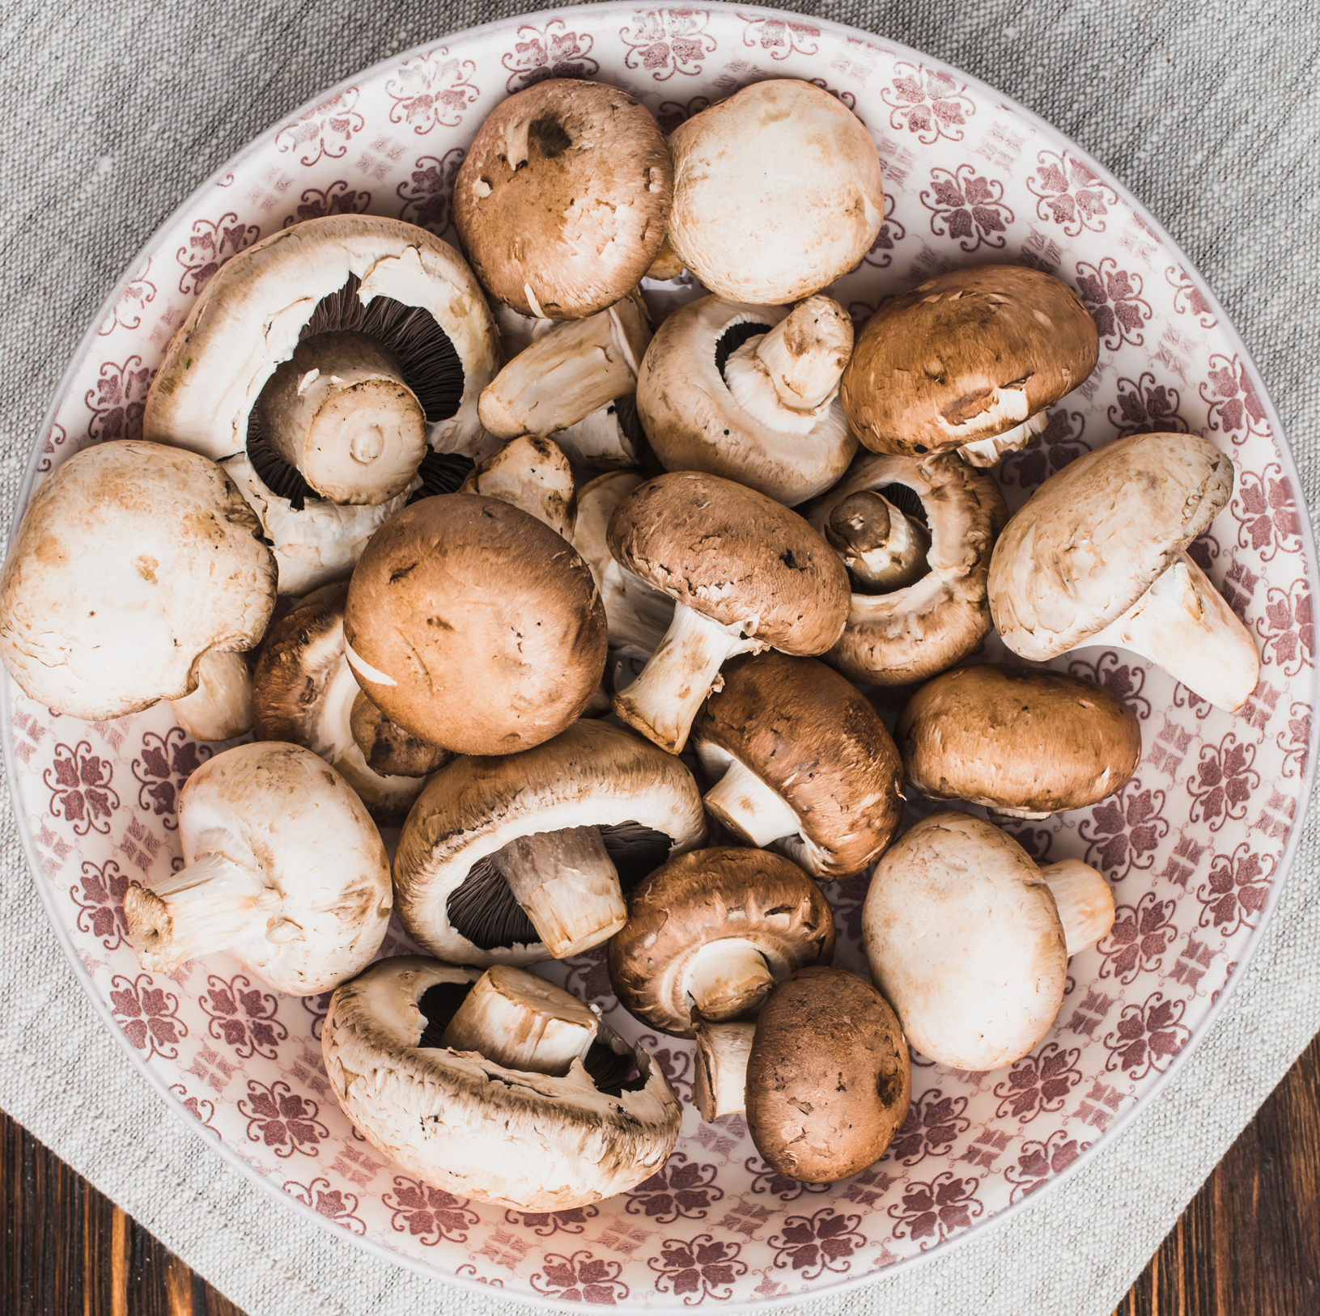
Introduction
The mushroom dataset includes descriptions of hypothetical samples corresponding to 23 species of gilled mushrooms in the Agaricus and Lepiota Family (pp. 500-525).
The task given is a binary classification problem whereby, given the features of mushrooms, we are to classify the mushrooms into p=Poisonous or e=edible.
Modelling Objective
Build a Simple and Interpretable Model to Perform Binary Classification on the Edibility of Mushroom from Agarcius and Lepiota Family.

Slide 4
EDA
01
Understands the dataset and flag out flaws in the dataset.

Slide 5
Data Exploration
Columns | Descriptions | Remarks
is-edible | poisonous=p, edible=e | Target Variable with Balanced Label
cap-shape | bell=b,conical=c,convex=x,flat=f, knobbed=k,sunken=s | Low Observation Count for Minority Class
cap-surface | fibrous=f,grooves=g,scaly=y,smooth=s | Low Observation Count for Minority Class
cap-color | brown=n,buff=b,cinnamon=c,gray=g,green=r,pink=p,purple=u,red=e,white=w,yellow=y | Low Observation Count for Minority Class
bruises | bruises=t,no=f | Binary Column (2 Unique Values)
odor | almond=a,anise=l,creosote=c,fishy=y,foul=f, musty=m,none=n,pungent=p,spicy=s | Low Observation Count for Minority Class
gill-attachment | attached=a,descending=d,free=f,notched=n | Binary Column (2 Unique Values)
gill-spacing | close=c,crowded=w,distant=d | Binary Column (2 Unique Values)
gill-size | broad=b,narrow=n | Binary Column (2 Unique Values)
gill-color | black=k,brown=n,buff=b,chocolate=h,gray=g,green=r,orange=o,pink=p,purple=u,red=e,white=w,yellow=y | Low Observation Count for Minority Class
stalk-shape | enlarging=e,tapering=t | Binary Column (2 Unique Values)
stalk-root | bulbous=b,club=c,cup=u,equal=e, rhizomorphs=z,rooted=r,missing=? | 30.5 % (2480 Rows) of Missing Values
stalk-surface-above-ring | fibrous=f,scaly=y,silky=k,smooth=s | Low Observation Count for Minority Class
stalk-surface-below-ring | fibrous=f,scaly=y,silky=k,smooth=s | Low Observation Count for Minority Class
stalk-color-above-ring | brown=n,buff=b,cinnamon=c,gray=g,orange=o,pink=p,red=e,white=w,yellow=y | Low Observation Count for Minority Class
stalk-color-below-ring | brown=n,buff=b,cinnamon=c,gray=g,orange=o,pink=p,red=e,white=w,yellow=y | Low Observation Count for Minority Class
veil-type | partial=p,universal=u | Constant Value Column ‘veil-type= p’
veil-color | brown=n,orange=o,white=w,yellow=y | Low Observation Count for Minority Class
ring-number | none=n,one=o,two=t | Discrete Numerical Columns
ring-type | cobwebby=c,evanescent=e,flaring=f,large=l,none=n,pendant=p,sheathing=s,zone=z | Low Observation Count for Minority Class
spore-print-color | black=k,brown=n,buff=b,chocolate=h,green=r,orange=o,purple=u,white=w,yellow=y | Low Observation Count for Minority Class
population | abundant=a,clustered=c,numerous=n,scattered=s,several=v,solitary=y | Low Observation Count for Minority Class
habitat | grasses=g,leaves=l,meadows=m,paths=p,urban=u,waste=w,woods=d

Slide 6
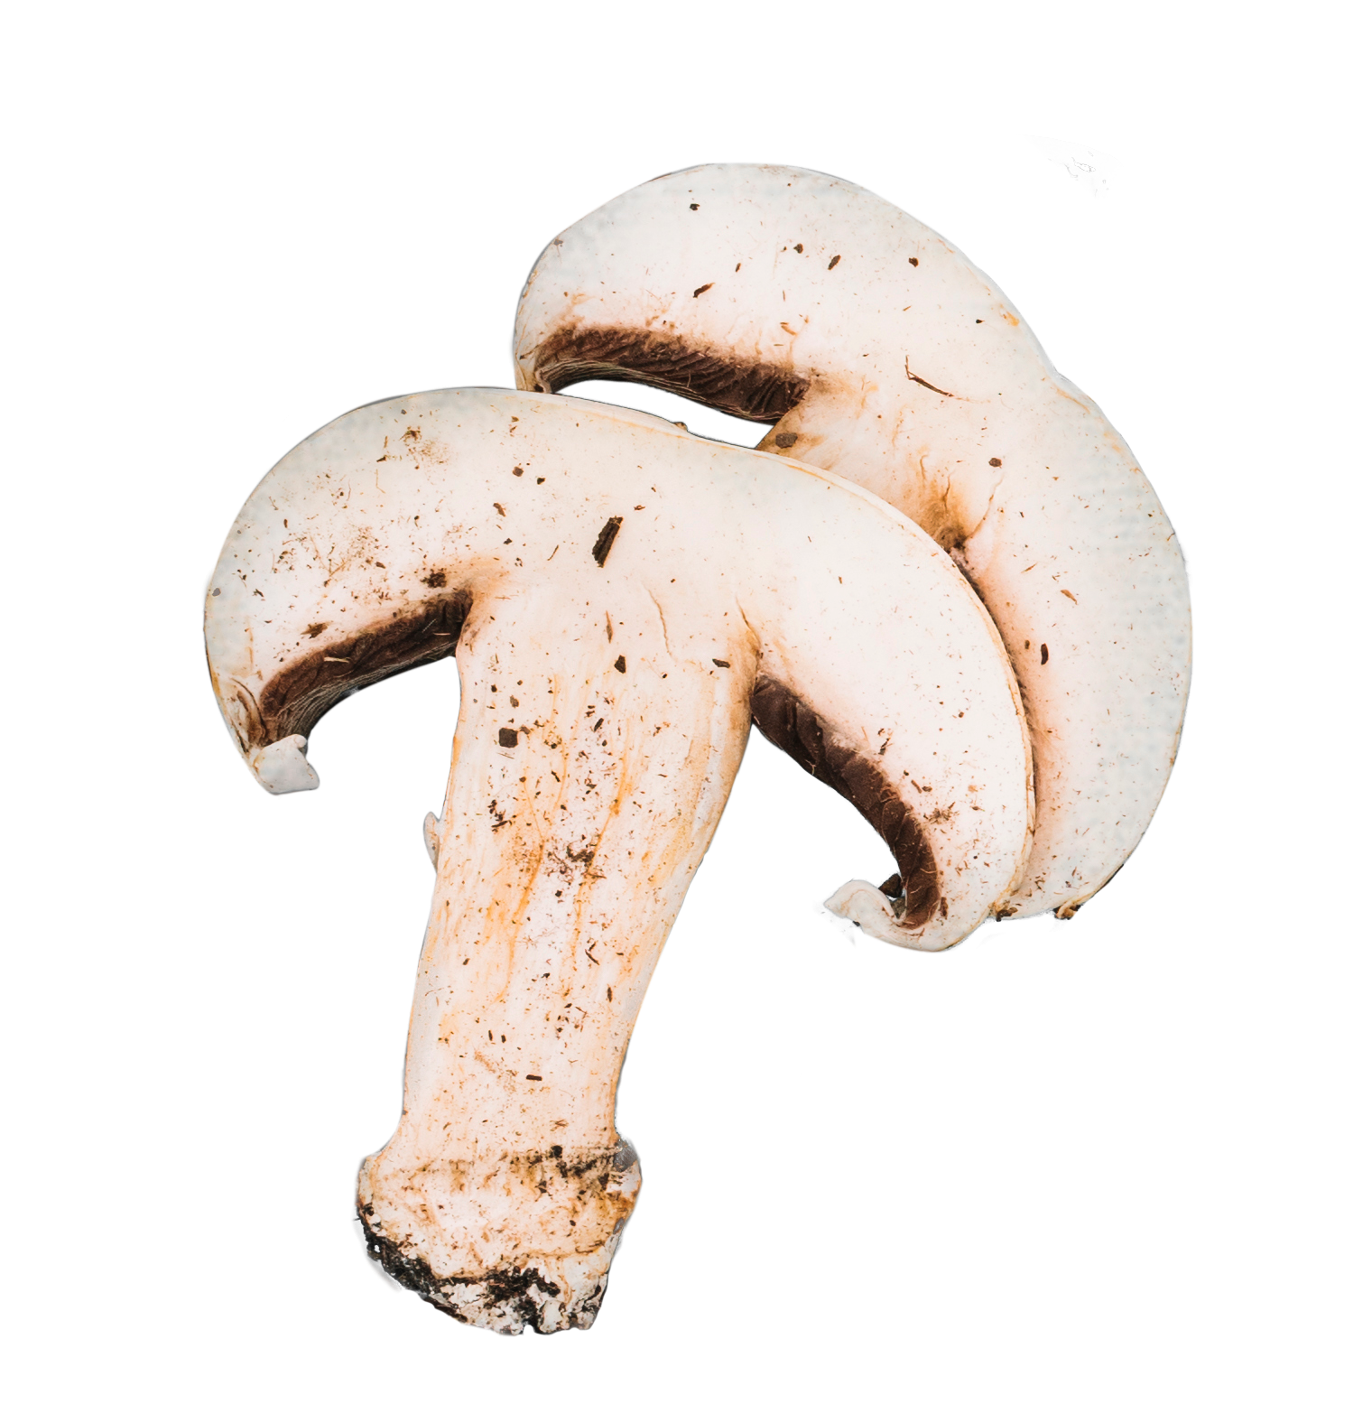
EDA Summary
Constant Column
Missing Values
Binary Columns
High Cardinality
veil-type shall be dropped as it does not bring any information of target variable
Data Cleaning / Imputation is needed to treet missing values for stalk-root
Perform dummy encoding towards binary columns and One-Hot Encoding to other nominal categorical columns
High cardinality and low observation count in minority classes prompts us to perform feature selection to reduce dimension of dataset.

Slide 7
Data Preprocessing
02
Preprocess dataset into a format that is digestible by model.

Slide 8
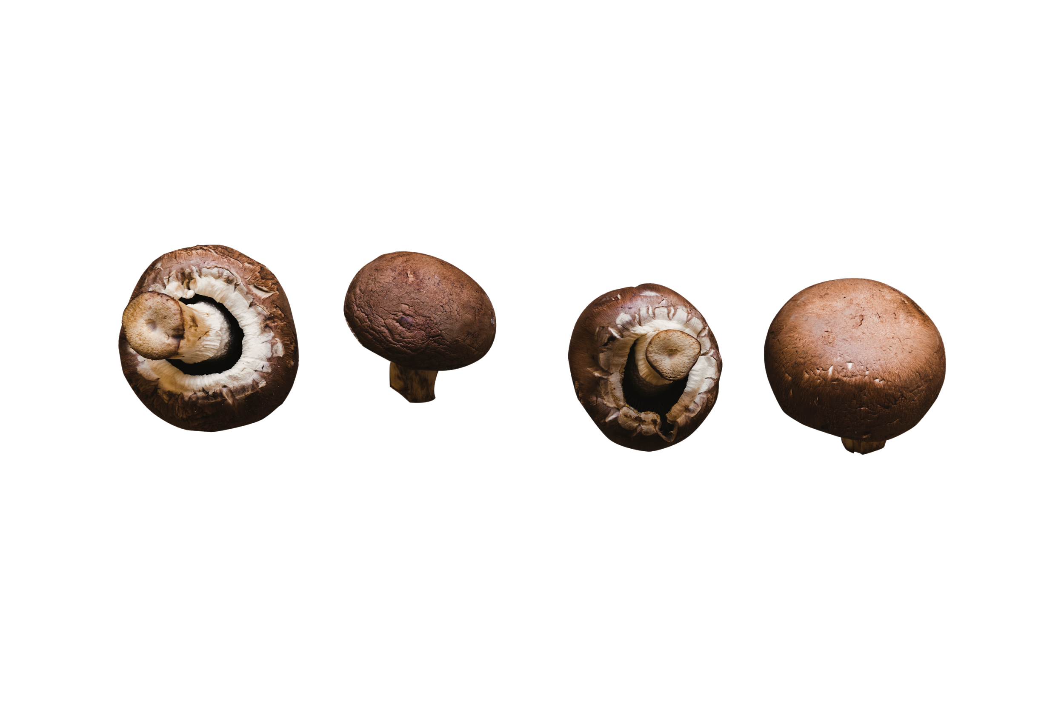
Preprocessing Steps
01
02
03
04
Drop Constant Value Column
Drop Missing Value Column
Feature Selection (Cremer’s V Correlation)
Feature Encoding (Dummies Encoding + One-Hot Encoding)
05
Recursive Feature Elimination (RFE)

Slide 9
Drop Constant Value Column
veil-type column is dropped as it have constant value of "p" which does not bring any information about the target variable.
Data Cleaning and Imputation
Since there are around 30.2% of missing values observed for stalk-root feature, we can tryout the following approaches:
Drop the Entire stalk-root Column
Impute with Central Tendency(most-frequent = "b")
Impute with Advanced Algorithm in SKLearn (e.g. IterativeImputer, KNNImputer)
We will go with the first approach since it is the simplest solution that does not change the underlying distribution of dataset. We can evaluate the decision based on the model's performance later.

Slide 10
Feature Selection
Although we have a total of 107 features after feature encoding, some of the feature might not be useful for modelling as it have too little occurrence, or they are just noises that does not bring any information about the target variable.
For that, feature selection is needed to investigate more on the strong and weak features and how we could perform some feature engineering before we start our modelling.
*All investigation and inference is made with the training set to minimize any data leakage which leads to biased result during model evaluation.

Slide 11
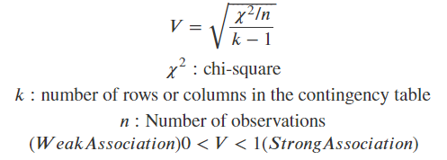
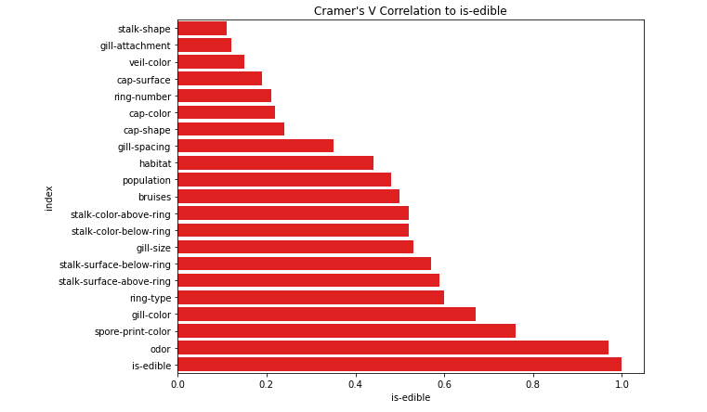
Cramer's V Correlation Matrix
Cramer's V is a statistical test to calculate correlation in tables which have more than 2x2 rows and columns. It is used as post-test to determine strengths of association after chi-square has determined significance.
Reference : Cramer's V correlation matrix

Slide 12
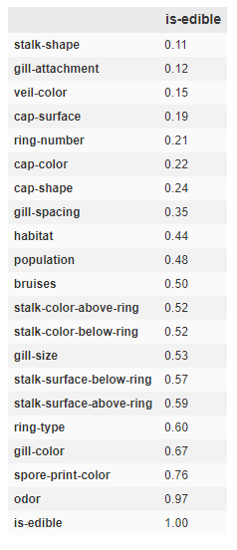
Cramer's V Correlation Matrix
From the Cremer's V statistical test, the following are the observations:
'Odor' seems to be a strong measure as the association between odor with the target variable, 'is-edible' is very high.
There seems to be little association between ['stalk-shape', 'gill-attachment', 'veil-color', 'cap-surface', 'ring-number', 'cap-color', 'cap-shape’] with target variable, "is-edible".
This might be due to the present of some minority classes(values with little observation) or there are simply no association.
To test out the hypothesis above, we print out the contingency table for features with low Cremer's V score and perform some basic visualisation.

Slide 13
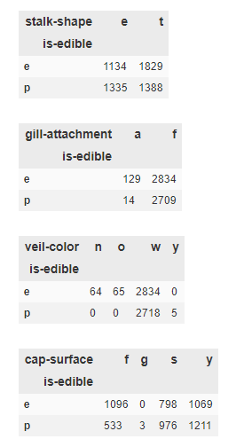
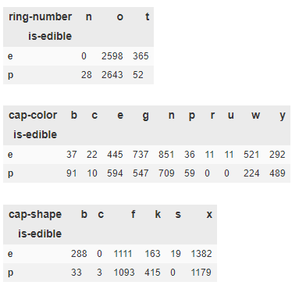
Cramer's V Correlation Matrix
By analysing the printed cross-tab the following are the observations:
For the features that are flagged as weak association to the target variable, some of the values seems to be a strong split and can make up a strong feature once One-Hot encoded (e.g. gill-attachment, veil-color, ring-number, cap-shape)
However, there are also features where all the values are ambiguous in classifying the target variable.(e.g. stalk-shape, cap-surface)
Although there might be some hidden relationship when we take account of combination for more than one features, we first attempt to drop ["stalk-shape", "cap-surface"] features from our dataset and revisit the decision after modelling.

Slide 14
Feature Encoding (Dummies Encoding + One-Hot Encoding)
Dummies Encoding
Encode binary categorical columns to avoid high correlation between encoded features.
One-Hot Encoding
Encode Nominal Categorical Columns into One-Hot features.

Slide 15
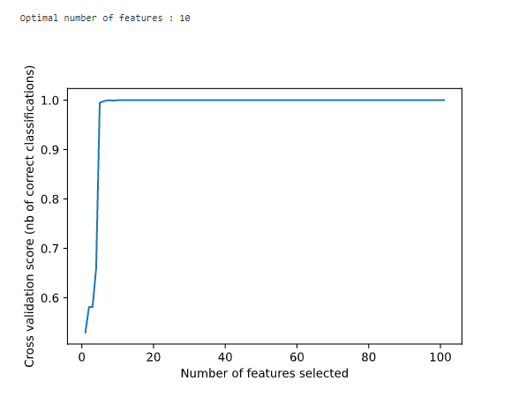
Recursive Feature Elimination
As we have 101 features after feature encoding, to get a simpler model, we make use of Recursive Feature Elimination with Support Vector Machine running linear kernel to perform feature selection for us.
By ranking the features through the score generated by LinearSVM, which can find the best linear split with maximum margin, RFE reduced the number of features recommended into just 10 features, which we will be using the selected features for modelling later on.

Slide 16
Modelling
03
Train and Evaluate Models based on Modelling Objective.

Slide 17
Modelling
After we have performed feature selection to limit down the number of features from 107 features to just 10 features, we are ready to make use of some Sci-kit Learn model to see whether can we find some simple yet interpretable model that can help us classify whether is a mushroom poisonous.
We will first begin by exploring several simple statistical model with default parameters and make decision based on the evaluation outcome and also the interpretability.

Slide 18
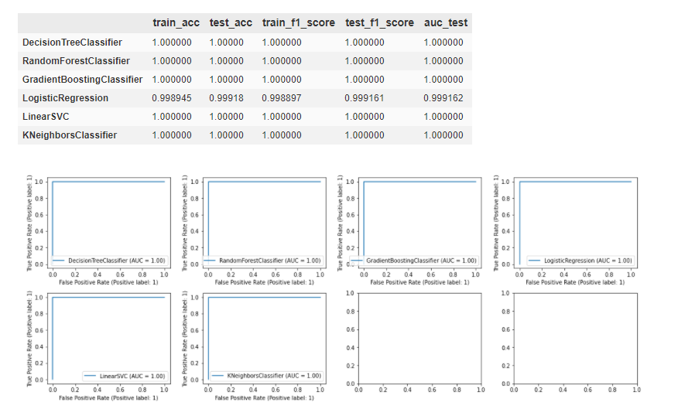
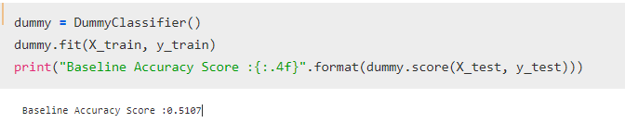
Baseline Model & Model Selection
Dummy Classifier
We use Dummy Classifier by predicting the most dominant classes : Poisonous = False and evaluate the score of the baseline predictor as reference point for model selection.
Model Selection
We have built a custom function to train and evaluate the performance of multiple models using accuracy_score, f1_score as well as auc_roc curve as metrics to evaluate the performance.
From the accuracy report, we noticed that all the models performs quite well out-of-the-box(without hyperparameter tuning) with accuracy and AUC of 1.0 for most model except Logistic Regression.
As the goal of modelling is to find the simplest model, with high interpretability, we continue by looking into DecisionTreeClassifier and perform some hyperparameter tuning to see can we get a simpler model that is still able to generalize to the sample data well.

Slide 19
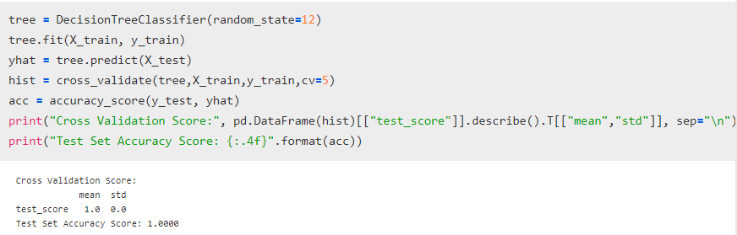
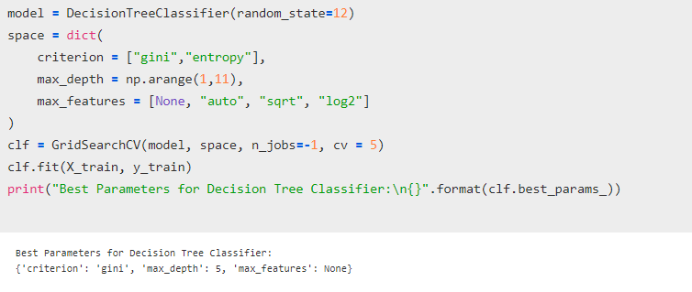
Model Evaluation & Hyperparameter Tuning
With the goal of simplifying the model, we perform hyperparameter tuning towards the max_depth of model to reduce the complexity of model.
From the evaluation metrics, we observed accuracy of 1.0 during K-Fold Cross Validation and also for Hold-Out Test Set, which has not been seen by the algorithm.
Hence, we continue by carrying out hyperparameter tuning to further simplify the model for better interpretability.

Slide 20
Model Interpretation
04
Interpret the model and its decision rule.

Slide 21
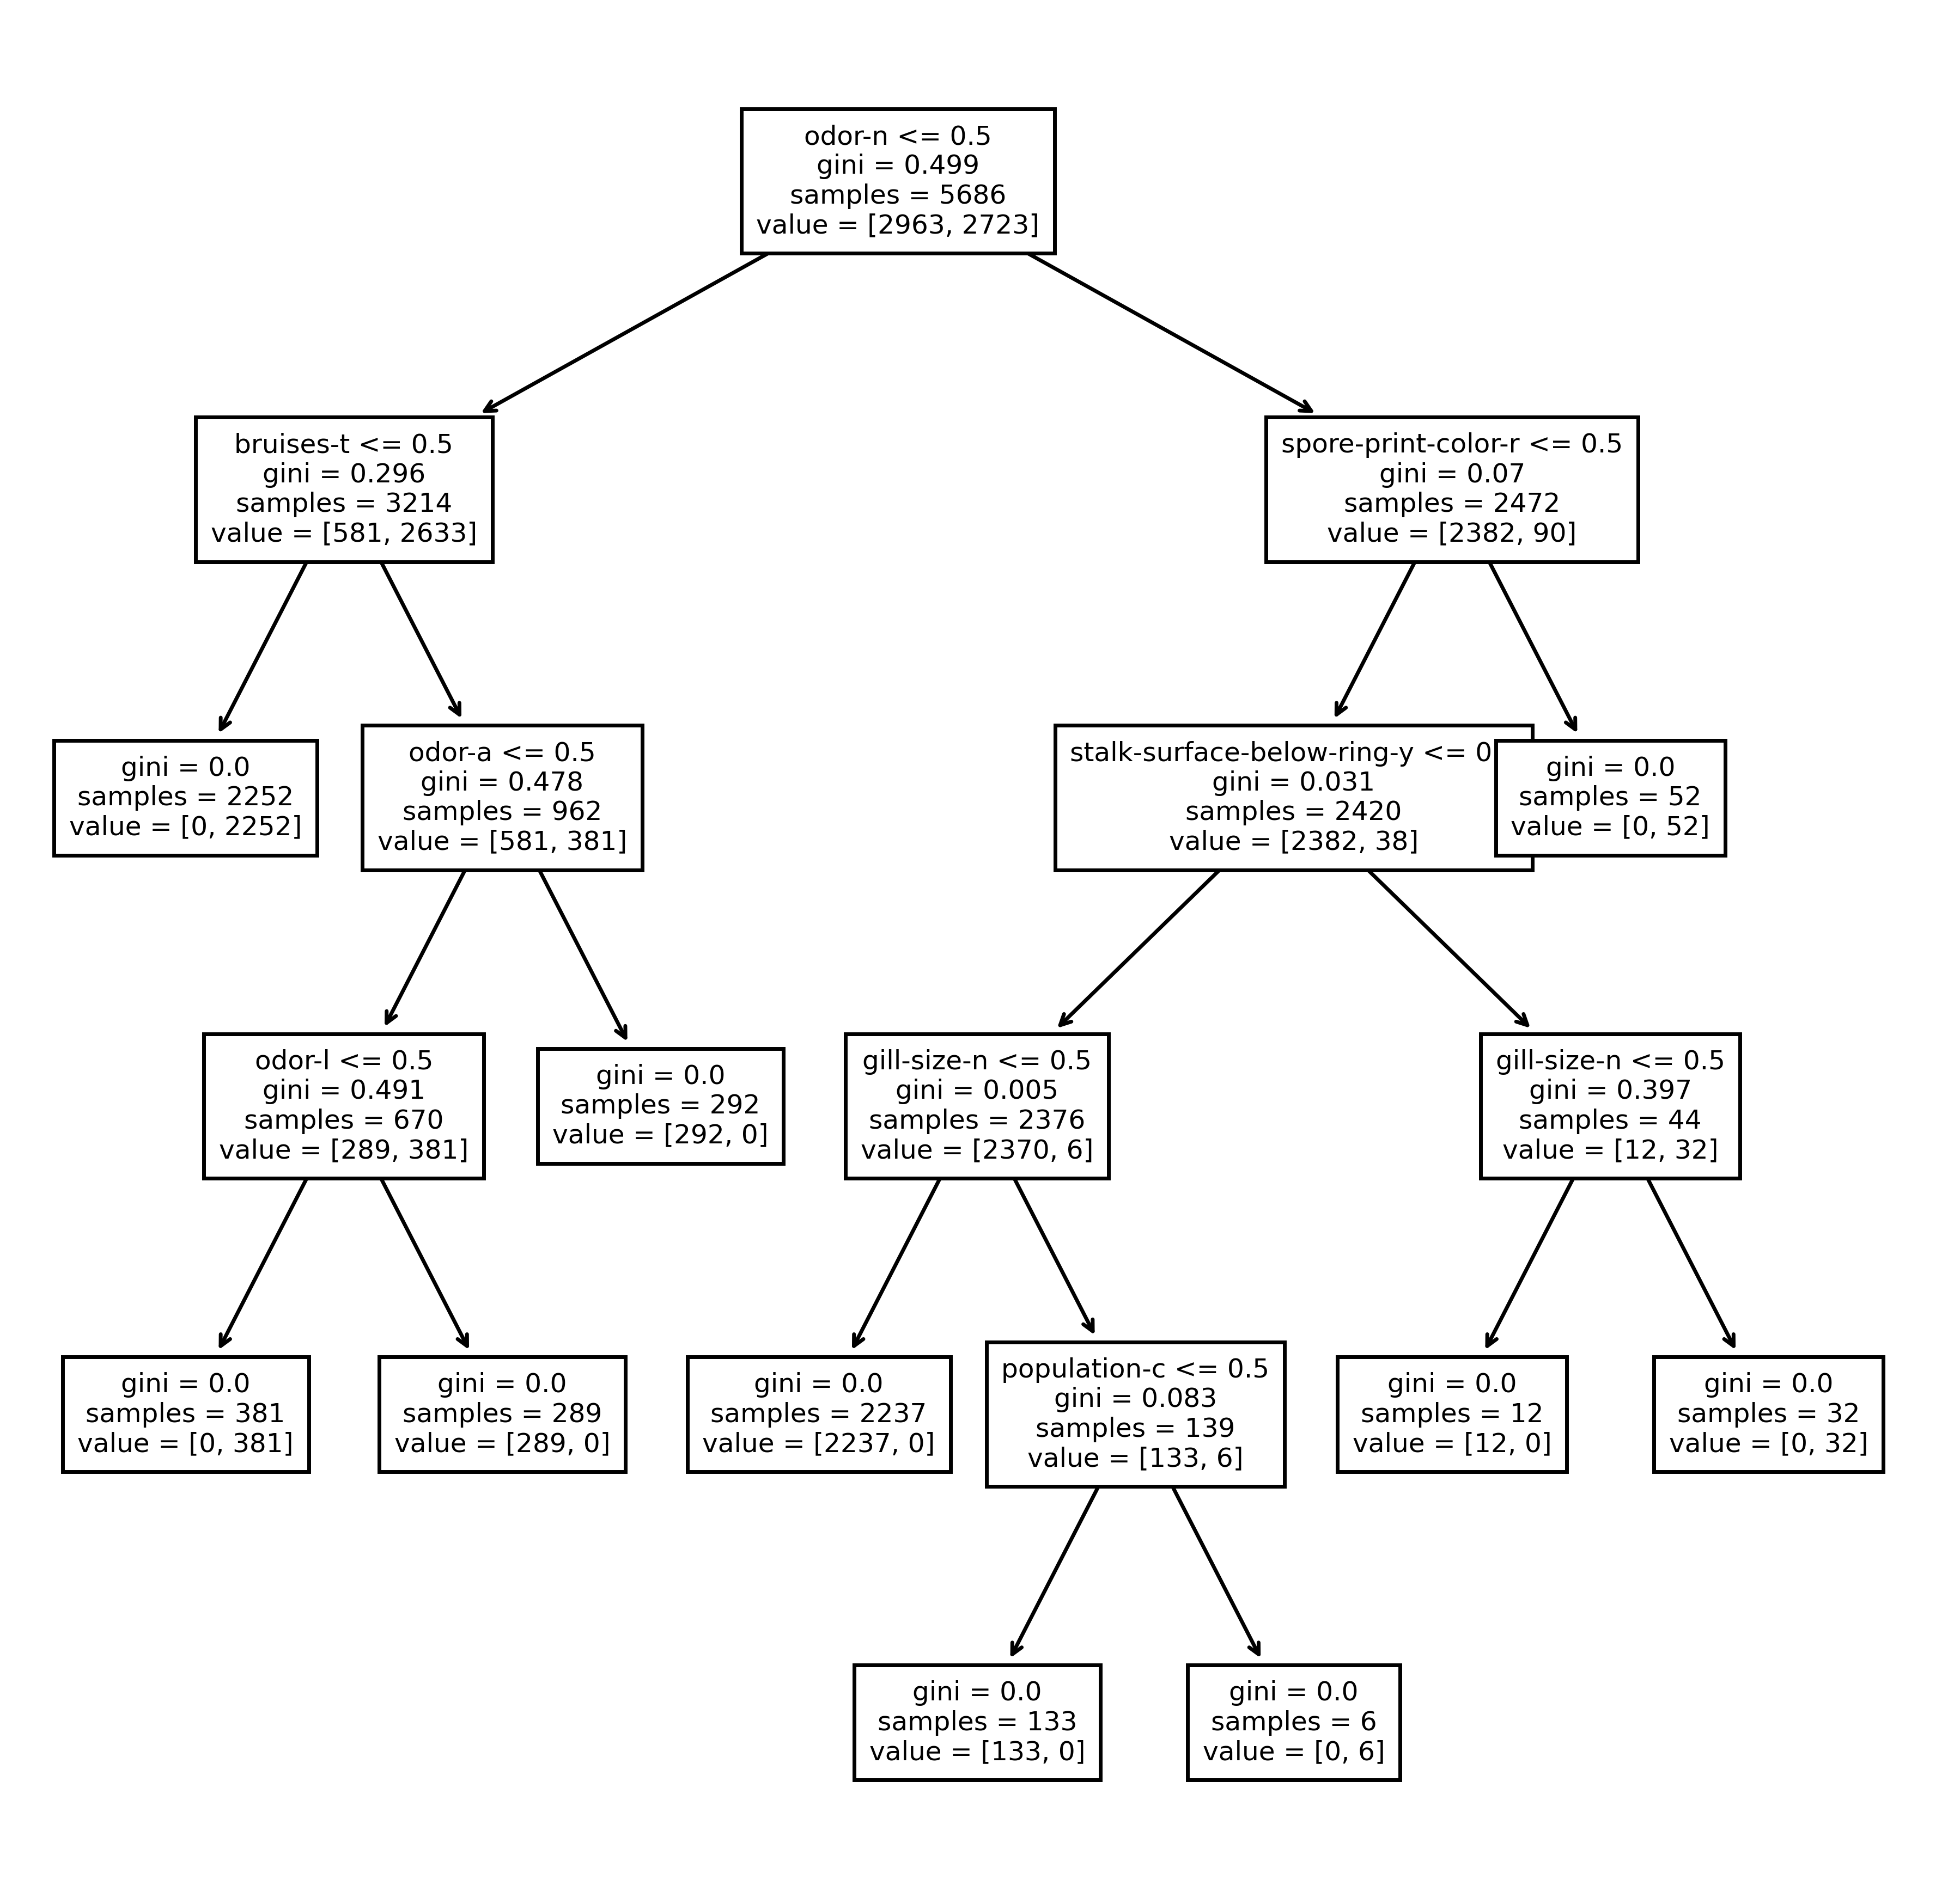
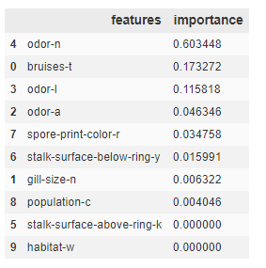
Feature Importance & Visualizing Decision Tree
By using the best parameters generated from Grid Search Cross-validation, we train our final model and gain some insights by visualising the decision rule of the decision tree.
Feature Importance
Visualising Decision Tree
From the feature importance we can tell that out of the 10 selected features, only 8 of them are used in the decision rule and odor-n which represents No-odor, is the best-feature with highest feature importance.
Meanwhile, "Black Stalk Surface Above Ring, Woods Habitat" is not utilise based on the decision rule.
Hence, we can conclude that by using only 8 true or false values, we can effectively classify whether is a mushroom poisonous or edible.

Slide 22
Conclusion
From dataset with 22 categorical columns and more than 100 dummies features, we managed to spot and rectify the errors (Single-Valued Columns, Null Values, etc) from the dataset and perform feature selection to limit down the number of features into just 10 before building the final model which only utilise only 8 features to achieve perfect classification based on the evaluation score from cross-validation and hold-out test set.

Slide 23


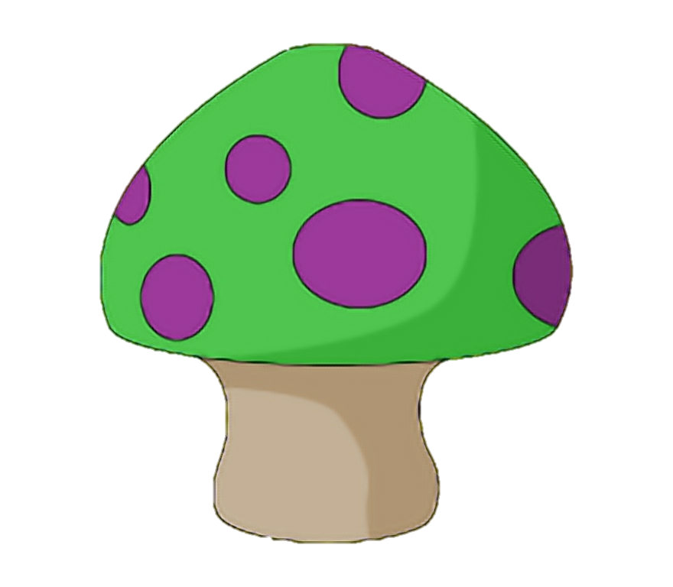
Thanks!
Personal Learning Reflection
Through the mushroom classification problem, I've gained more hands-on exposure in terms of Feature Selection and Feature Elimination which is something new to me as in the past, I am more obsessed with chasing the scores at cost of model complexity. Since we can get perfect score with any modern classification models effortlessly with the mushroom dataset, Model Interpretation becomes the highlight since a black-box model might not be as useful than a Simple Decision Map for an adventurer collecting mushroom in the woods!
Written By : Wong Zhao Wu
Last Modified : 22 May 2021
CREDITS: This presentation template was created by Slidesgo, including icons by Flaticon, infographics & images by Freepik
Images Credits: pngtrees, KindPNG, Pinclipart

